Slide 1
Oxygenated State
Transitional State
Hypoxic State
Hydrologic
Controls
Biological
Controls
Hydrologic
Controls
Biological
Controls
=
Hydrologic
Controls
<
Biological
Controls
<<
- DO +
- DO +
- DO +
- Time +
- Time +
- Time +
+
Network Extent
-

Slide 2
State 1: Oxygenated
State 2: Transitional
State 3: Hypoxic
Hydrologic Controls
=
Biological Controls
Hydrologic Controls
<
Biological Controls
Hydrologic Controls
≪
Biological Controls
- DO +
- DO +
- DO +
- Time +
- Time +
- Time +
-
+
Network Extent

Slide 3
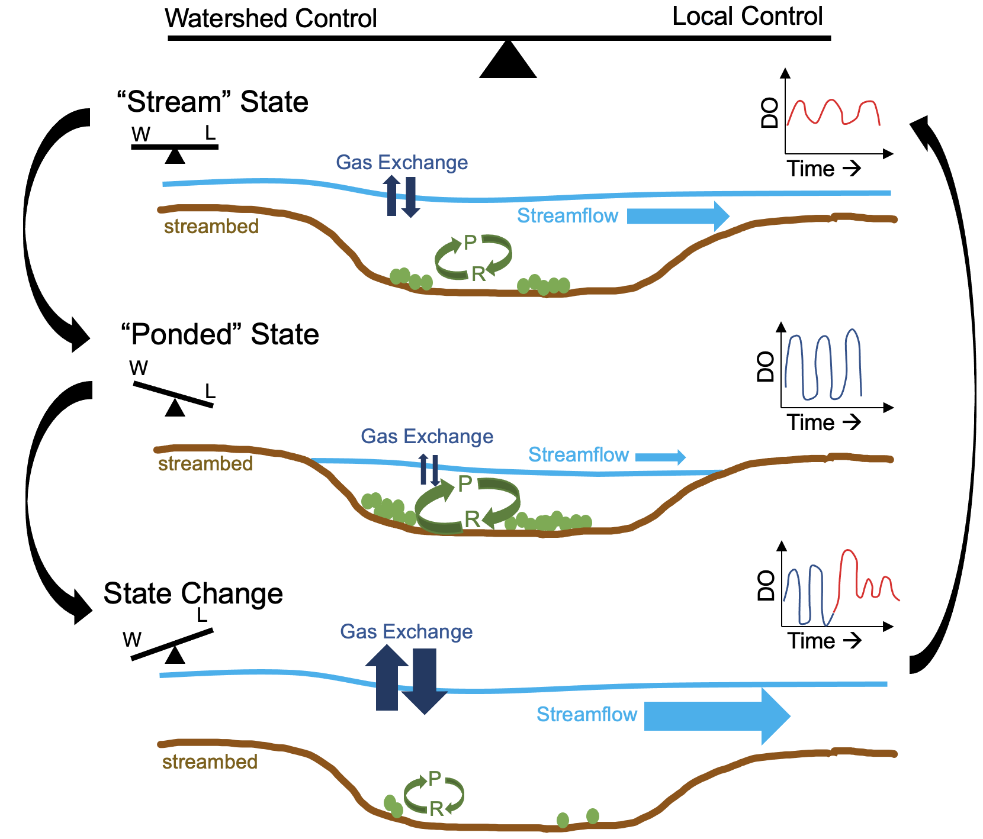
Oscillating watershed & local controls as a defining feature of non-perennial streams
“Flowing” state (lotic): oxygen dynamics are controlled by a combination of watershed hydrologic controls (downstream flow, gas exchange) and local, biological processes (ecosystem metabolism)
“Pooled” state (lentic): oxygen dynamics become strongly influenced by local controls (ecosystem metabolism)
Rewetting acts as state change in the system, flushing out accumulated low oxygen water, scouring biofilms and aquatic vegetation, and enhancing gas exchange
Notes:
shifting watershed and local controls should be familiar, because this same axis was also central in our conceptual understanding of the control on dissolved streamwater chemistry
oscillation between watershed/hydrologic & local/biological controls is a defining feature of NPS; this same idea is also found in the literature on perennial streams – but often when thinking about high flows vs. baseflow - in NPS – we’re thinking about baseflow vs. very low flows/drying conditions (so flipping the other end of the flow continuum)

